Slide 1

Enhancing Snapchat E perience: Python- Based Face Filter Development with OpenCV, Mediapipe, and Numpy

Slide 2
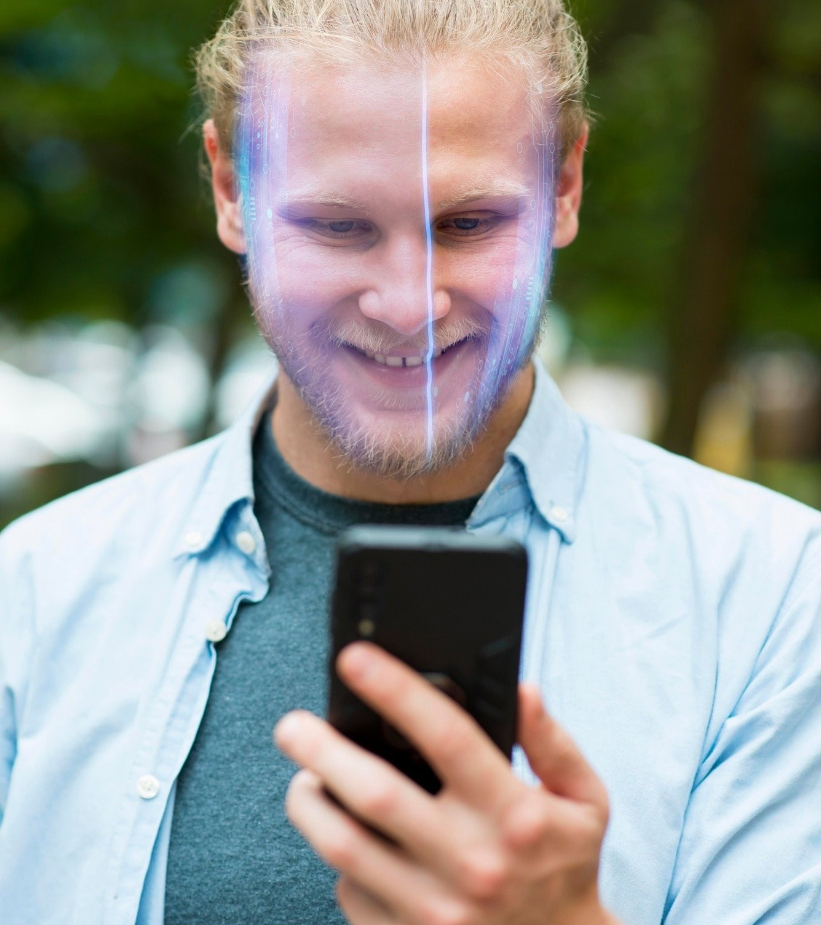
Introduction
Welcome to the presentation on Enhancing Snapchat Experience: Python-Based Face Filter Development with OpenCV, Mediapipe, and Numpy.
In this presentation, we will explore how these powerful libraries can be utilized to create engaging and interactive face ﬁlters for Snapchat. Get
ready to dive into the world of computer vision and image processing!

Slide 3

Understanding OpenCV
OpenCV, short for Open Source Computer Vision Library, is a powerful Python library for computer vision and image processing tasks. With its extensive collection of functions and algorithms, OpenCV provides the foundation for developing sophisticated face ﬁlters. From facial detection to feature extraction, OpenCV offers a wide range of tools to enhance the Snapchat experience.

Slide 4


E ploring Mediapipe
Mediapipe is a Python framework developed by Google that simpliﬁes the process of building multimedia pipelines. By leveraging Mediapipe's pre-built modules and functions, developers can easily incorporate real- time face tracking, landmark detection,
and pose estimation into their Snapchat
face ﬁlters. Let's explore the capabilities of Mediapipe and how it can enhance the user experience.

Slide 5
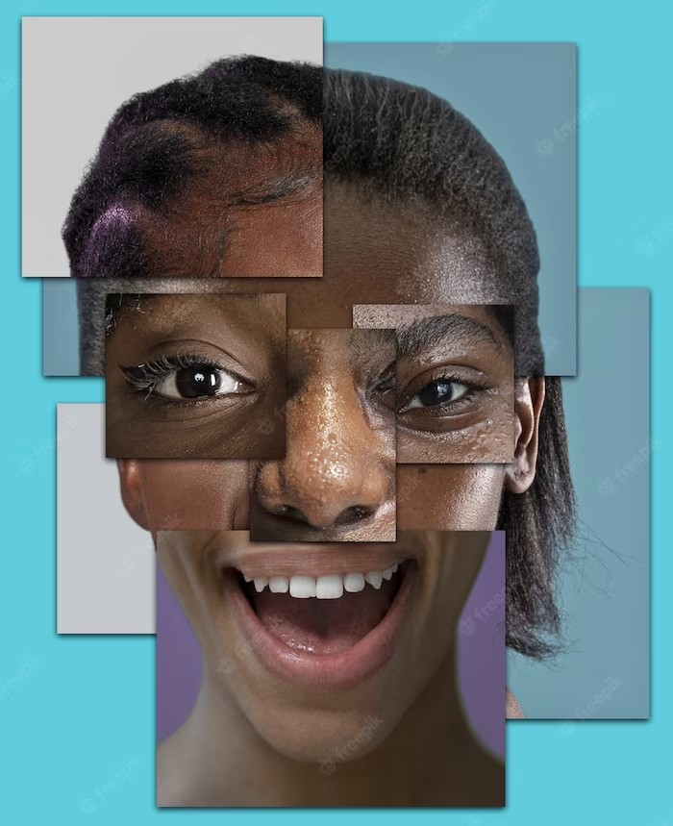
Utilizing Numpy
Numpy, short for Numerical Python, is a fundamental library for scientiﬁc computing in Python. With its powerful array manipulation capabilities, Numpy plays a crucial role in developing advanced image processing algorithms for Snapchat face ﬁlters. From applying ﬁlters to manipulating pixel values, Numpy provides the necessary tools to create stunning visual effects.

Slide 6

Python-Based Face Filter Development
Combining the power of OpenCV, Mediapipe, and Numpy, we can now delve into the process of Python- based face ﬁlter development. From capturing video frames to applying real-time ﬁlters, this slide will guide you through the step-by-step process of creating interactive face ﬁlters for Snapchat. Get ready to unleash your creativity and enhance the Snapchat experience!

Slide 7
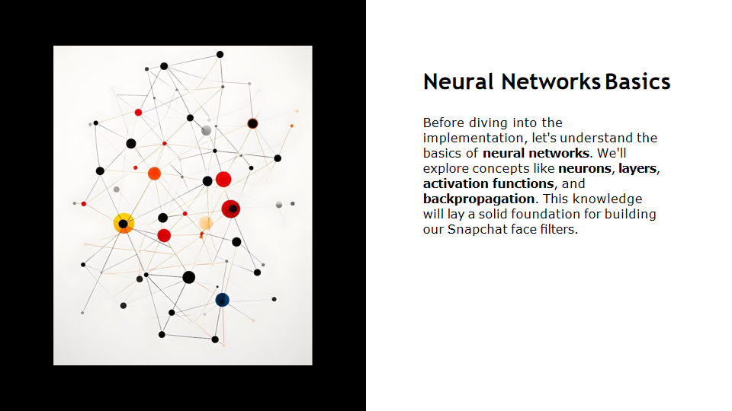

Slide 8
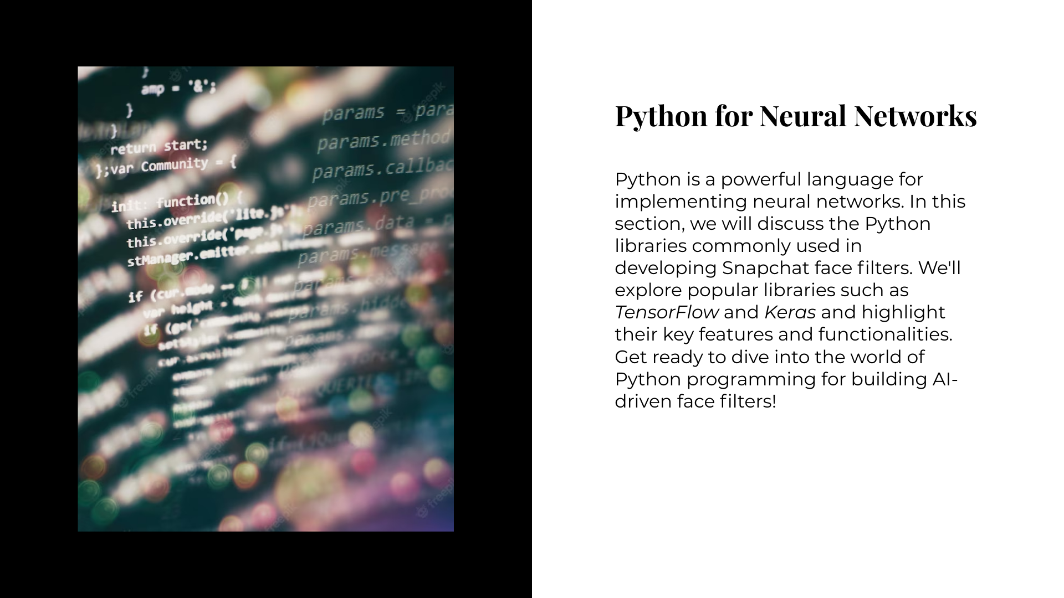

Slide 9
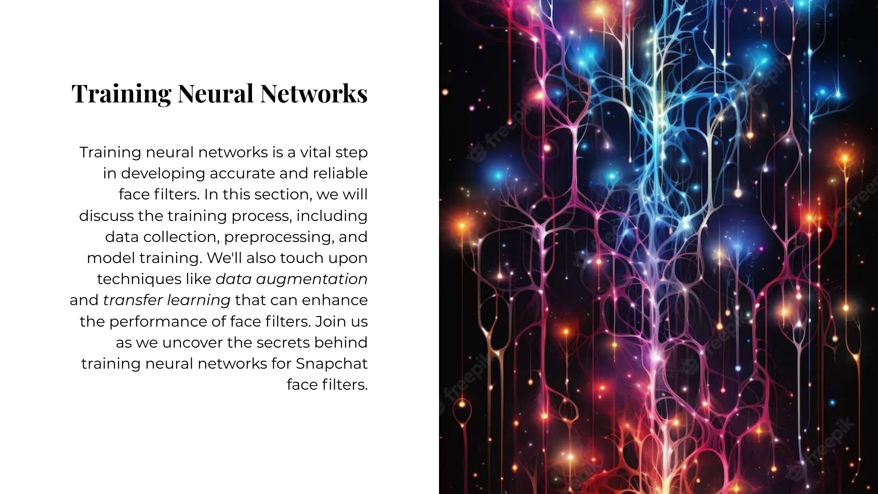

Slide 10
Conclusion
In conclusion, leveraging the capabilities of OpenCV, Mediapipe, and Numpy opens up a world of possibilities for enhancing the Snapchat experience. By utilizing computer vision techniques and advanced image processing algorithms, developers can create captivating and interactive face ﬁlters that engage users on a whole new level. Embrace the power of Python and these libraries to take your Snapchat ﬁlters to the next level!

Slide 11
Thanks
for your Attention!

